Slide 1
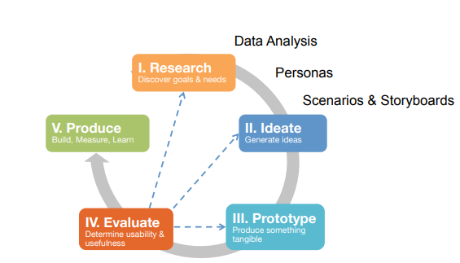

Slide 2
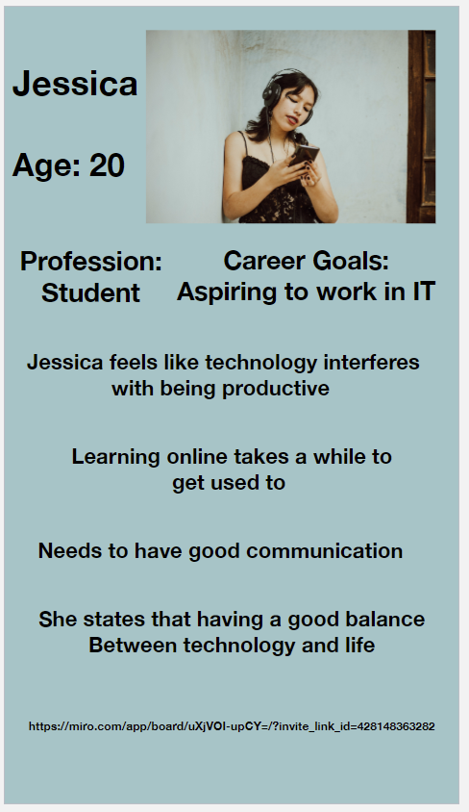
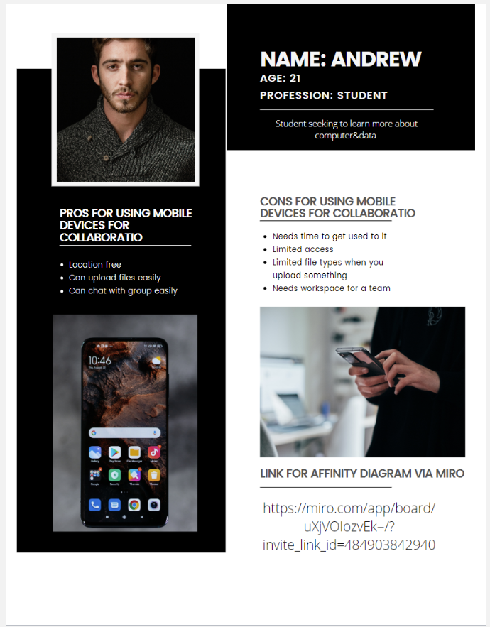
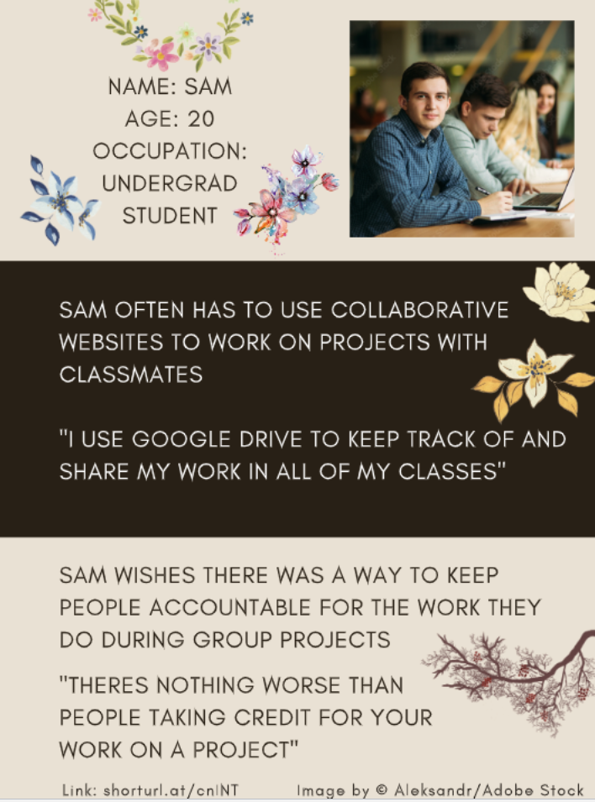
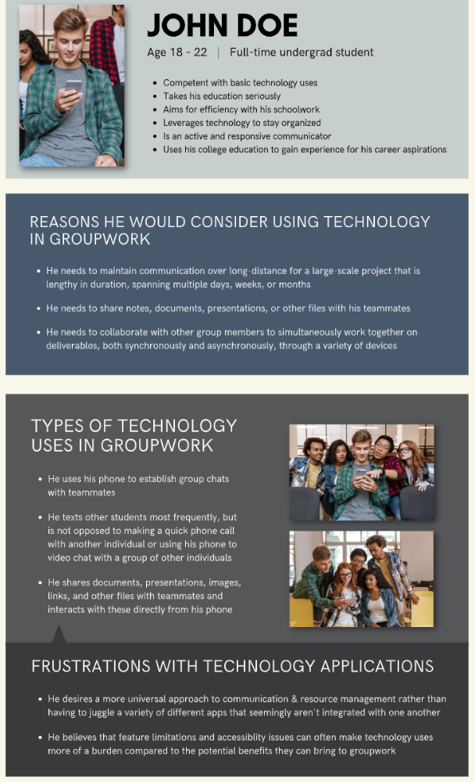
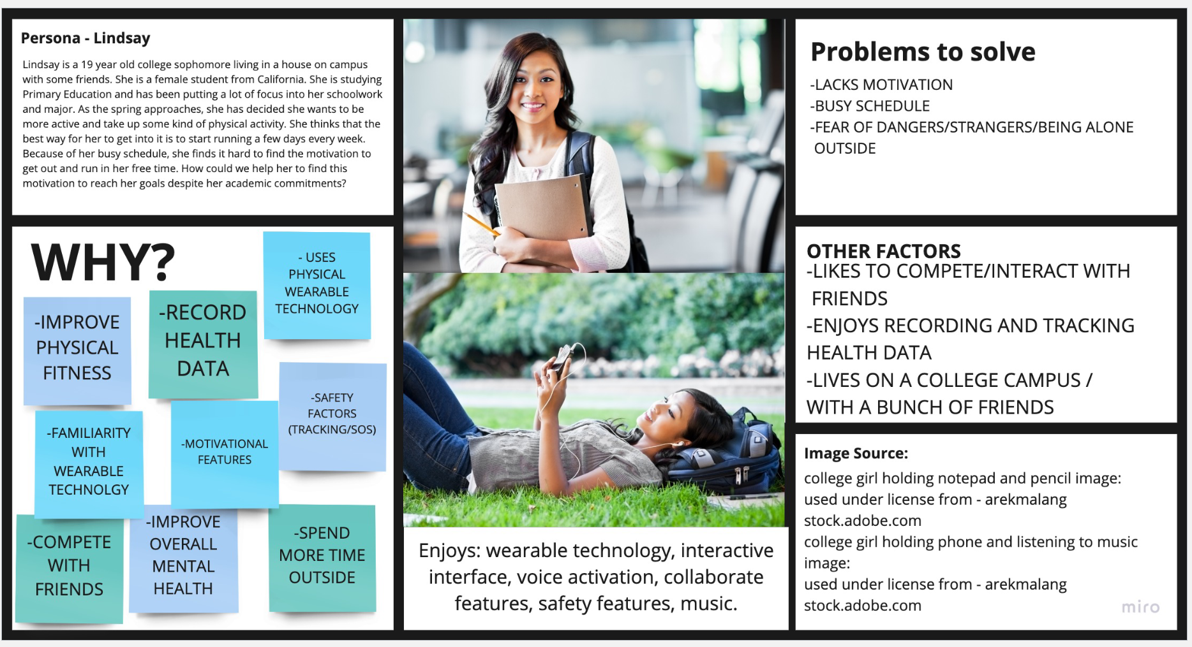
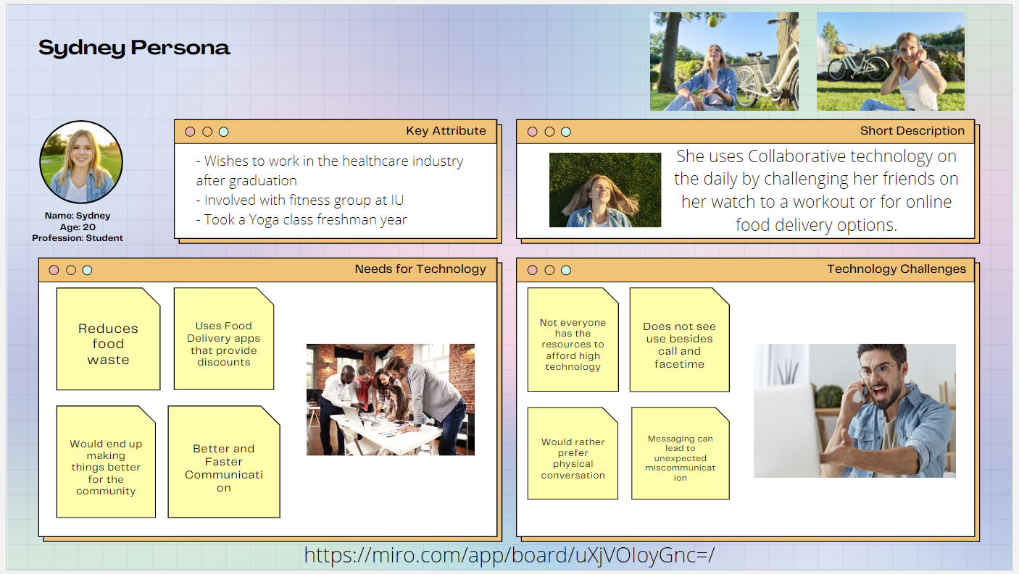
User Personas
Notes:
[15 minute mark]

Slide 3
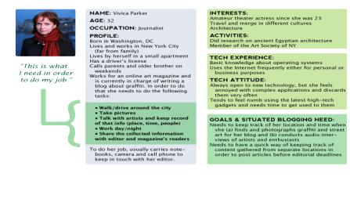
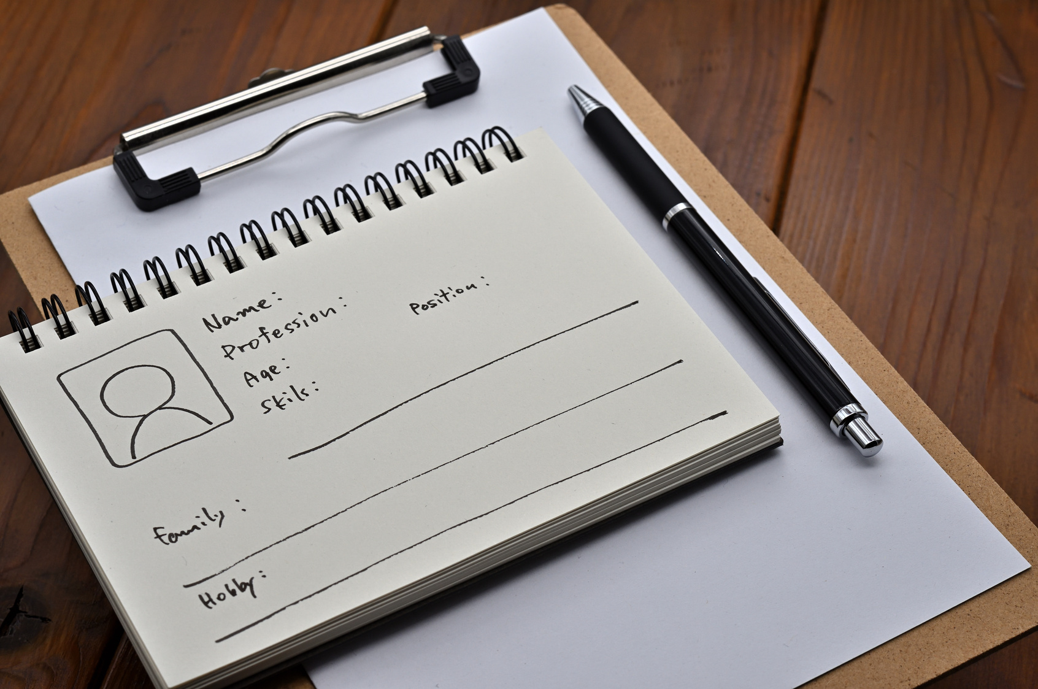
What are User Personas?

Slide 4

What are User Personas?
Personas originated from Alan Cooper’s (1999) need to synthesize and communicate design research for software development.
the people in charge, who are designing and creating a product or system (CEOs/managers/Software Engineers) are disconnected & unaware from the end-users needs and desires
Cooper, A. (1999). The inmates are running the asylum. In Software-Ergonomie’99 (pp. 17-17). Vieweg+ Teubner Verlag, Wiesbaden

Slide 5
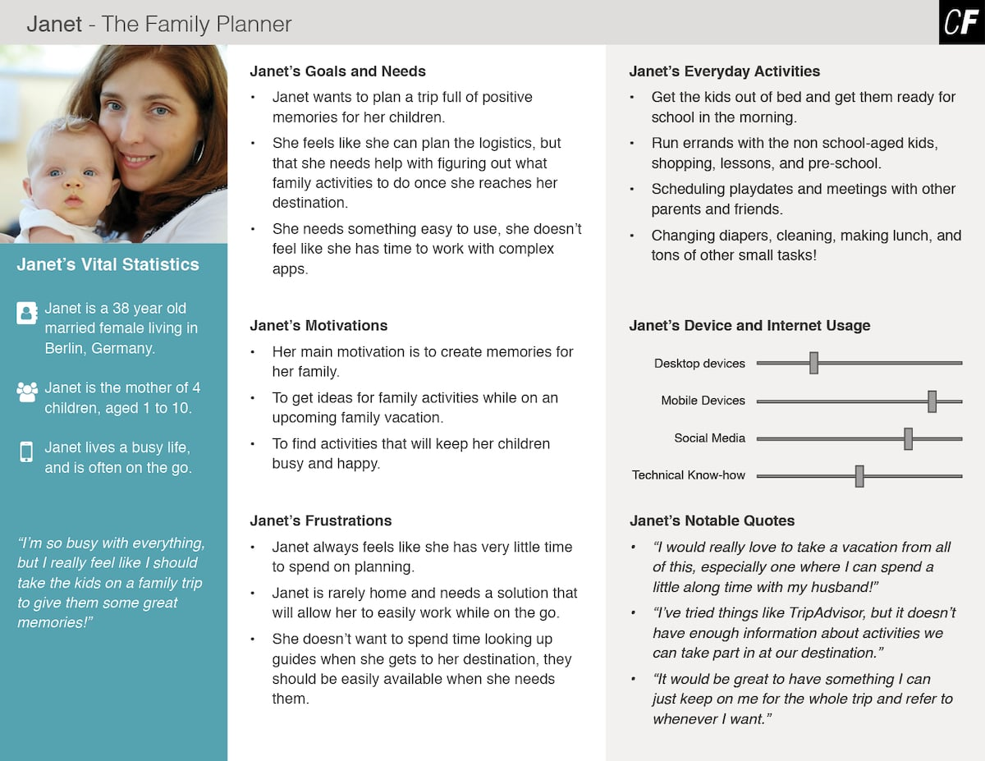
What are User Personas?
Personas are fictional characters used to represent typical users, customers or other stakeholders to reflect goals, attitude, and behavior when interacting with a particular product or service
The content of this lecture is developed mostly from:
Tomisch M. & Borthwick M. (2021). Design. Think. Make. Break. Repeat. BIS Publishers; 2nd edition.
Bella, M., & Hanington, B. (2012). Universal methods of design. Beverly, MA: Rockport Publishers, 204.
Notes:
https://www.google.com/url?sa=i&url=https%3A%2F%2Fcareerfoundry.com%2Fen%2Fblog%2Fux-design%2Fhow-to-define-a-user-persona%2F&psig=AOvVaw14t6gKb01AP8qP8x-LrWhl&ust=1678201582038000&source=images&cd=vfe&ved=0CBAQjhxqFwoTCMj_ya_Kx_0CFQAAAAAdAAAAABAh

Slide 6
What are User Personas?
Personas are fictional characters used to represent typical users, customers or other stakeholders to reflect goals, attitude, and behavior when interacting with a particular product or service
They are grounded in, and created from a synthesis of data from real people gathered through methods such as interviews and observations.
The content of this lecture is developed mostly from:
Tomisch M. & Borthwick M. (2021). Design. Think. Make. Break. Repeat. BIS Publishers; 2nd edition.
Bella, M., & Hanington, B. (2012). Universal methods of design. Beverly, MA: Rockport Publishers, 204.
Notes:
https://www.google.com/url?sa=i&url=https%3A%2F%2Fcareerfoundry.com%2Fen%2Fblog%2Fux-design%2Fhow-to-define-a-user-persona%2F&psig=AOvVaw14t6gKb01AP8qP8x-LrWhl&ust=1678201582038000&source=images&cd=vfe&ved=0CBAQjhxqFwoTCMj_ya_Kx_0CFQAAAAAdAAAAABAh

Slide 7
What are User Personas?
Personas are fictional characters used to represent typical users, customers or other stakeholders to reflect goals, attitude, and behavior when interacting with a particular product or service
They are grounded in, and created from a synthesis of data from real people gathered through methods such as interviews and observations.
Personas may be entirely fictionalized, but this is NOT recommended unless part of intentional approach.
Notes:
https://www.google.com/url?sa=i&url=https%3A%2F%2Fcareerfoundry.com%2Fen%2Fblog%2Fux-design%2Fhow-to-define-a-user-persona%2F&psig=AOvVaw14t6gKb01AP8qP8x-LrWhl&ust=1678201582038000&source=images&cd=vfe&ved=0CBAQjhxqFwoTCMj_ya_Kx_0CFQAAAAAdAAAAABAh

Slide 8
Why are User Personas important?
Personas consolidate archetypal descriptions of user behavior patterns into representative profiles.

Slide 9
Why are User Personas important?
Empathy
We are engaged by fictional characters all the time in movies and books
Focus
Constraints on the user population so that a design team can focus on a specific subset of users in specific situations while interacting with the to-be-designed product
Concentrate on the highest priority set of user goals and needs
Communication
Channels for conveying a broad range of quantitative and qualitative data
Assumptions about users made explicit

Slide 10
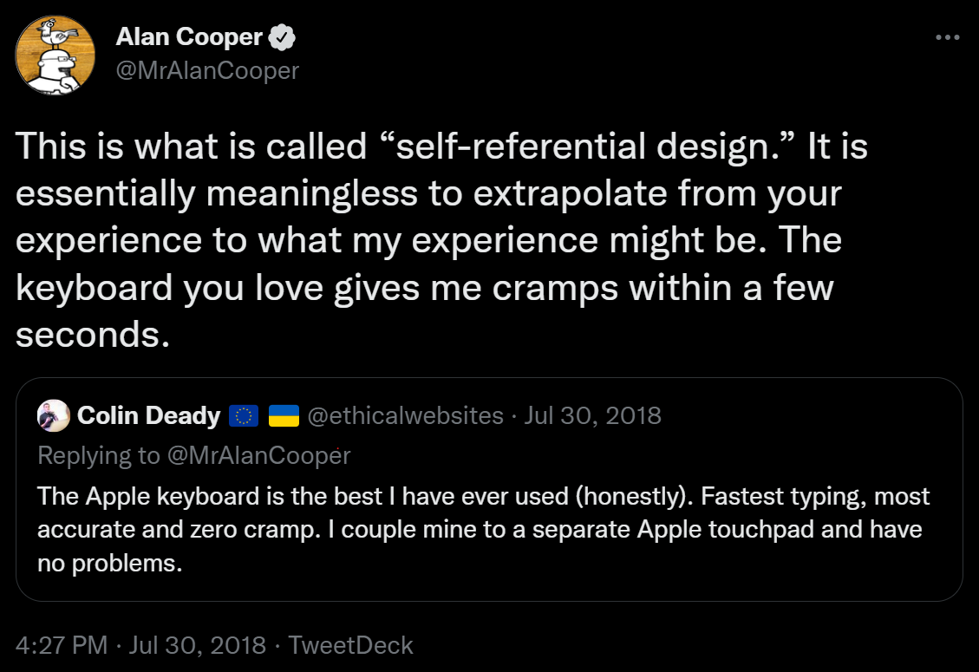
Why are User Personas important?
Personas help prevent common design pitfalls:
1. Self-referential design
Design for yourself instead for your target users / audience.
2. Design for elastic users
Which is an “an ill-defined user who's characteristics change to suit the needs of the developer” (Cooper, 1999) → You can stretch the user, until it fits your needs.
https://twitter.com/MrAlanCooper/status/1024028638344241153?s=20&t=RbMtCYJcZ6MNo-ZOGC0Vzg

Slide 11
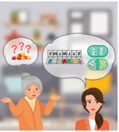
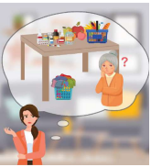
How to create a Persona?

Slide 12
Personas
Personas should be limited in number: 3-5 for any given project
You should try to differentiate the personas around needs and roles rather than by demographic information.
https://marketsplash.com/persona-examples/ https://bootcamp.uxdesign.cc/persona-does-it-really-improve-a-products-value-9037a937ead https://www.thinkingcapagency.com/blog/data-driven-student-personas/

Slide 13
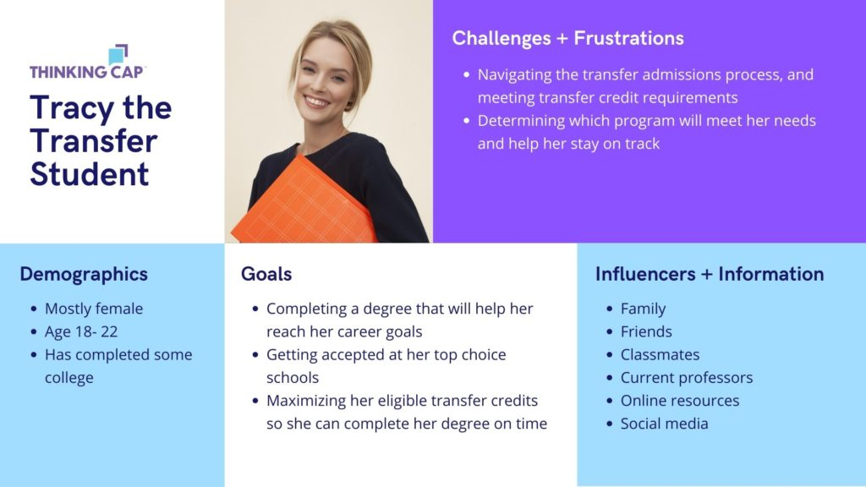
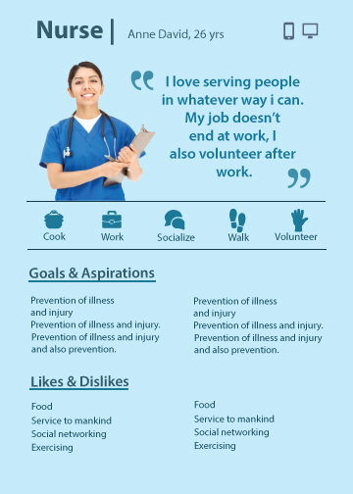
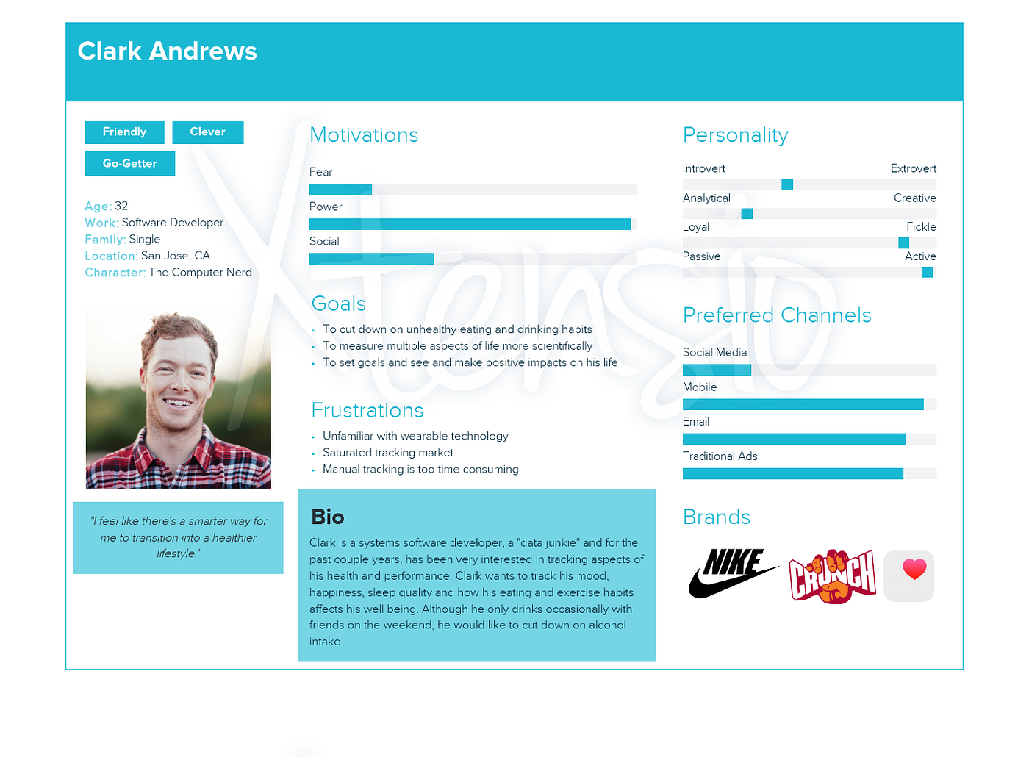
Personas
Personas should be limited in number: 3-5 for any given project
You should try to differentiate the personas around needs and roles rather than by demographic information.
Role: Transfer Student
Role: Nurse
Role: Software Engineer
https://marketsplash.com/persona-examples/ https://bootcamp.uxdesign.cc/persona-does-it-really-improve-a-products-value-9037a937ead https://www.thinkingcapagency.com/blog/data-driven-student-personas/

Slide 14
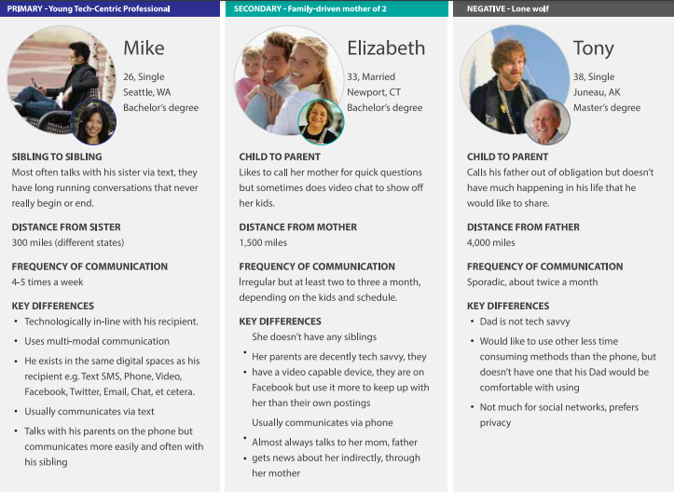
Personas
Personas should be limited in number: 3-5 for any given project
You should try to differentiate the personas around needs and roles rather than by demographic information.
https://marketsplash.com/persona-examples/ https://bootcamp.uxdesign.cc/persona-does-it-really-improve-a-products-value-9037a937ead https://www.thinkingcapagency.com/blog/data-driven-student-personas/

Slide 15
How Are User Personas Created?
1. Read through your Interviews and look at your Affinity Diagram to identify important variables, which may include:
Demographic data (who are they?)
Behavior variables (what do they do?)
Attitudinal variables (what do they feel?)

Slide 16
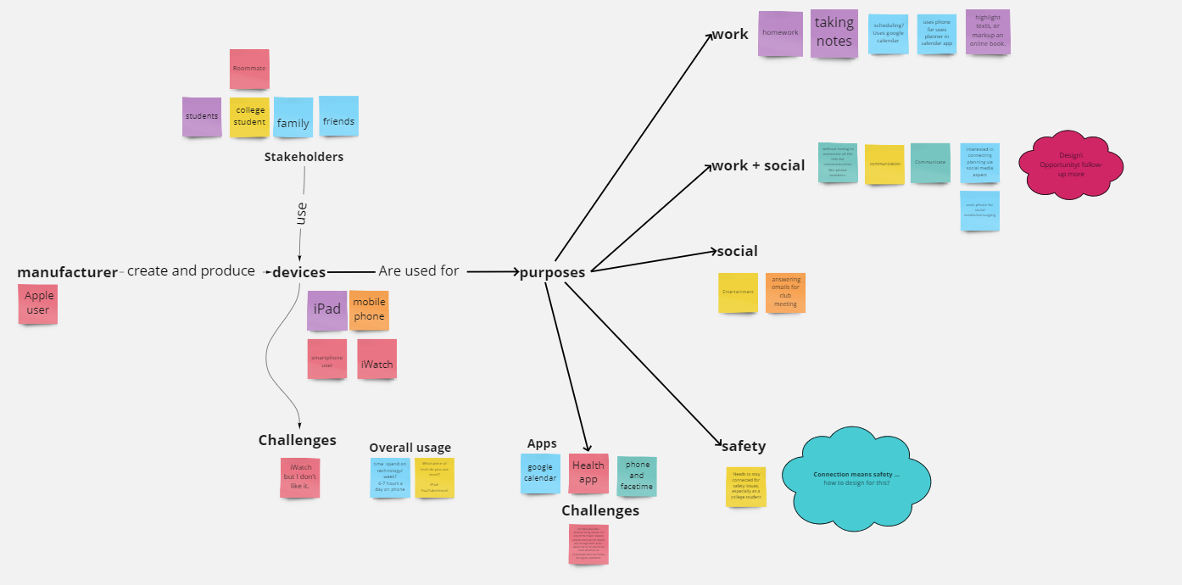
How Are User Personas Created?
1. Read through your Interviews and look at your Affinity Diagram to identify important variables, which may include:
Demographic data (who are they?)
Behavior variables (what do they do?)
Attitudinal variables (what do they feel?)
Try to find…
Demographic data
Behavior variables
Attitude variables

Slide 17
How Are User Personas Created?
2. Synthesize patterns in the data in a Google Doc or Sheet by looking for patterns or clusters across all the variables.

Slide 18
How Are User Personas Created?
Try to find…
Demographic data
Behavior variables
Attitude variables

Slide 19
How Are User Personas Created?
I3+I4+O1=
Demographics
Try to find…
Demographic data
Behavior variables
Attitude variables

Slide 20
How Are User Personas Created?
I5+O1=
Schoolwork
I3+I4+O1=
Demographics
I1+O1
Try to find…
Demographic data
Behavior variables
Attitude variables
I5+I3+O1= Technology Usage

Slide 21
How Are User Personas Created?
I5+O1=
Schoolwork
I3+I4+O1=
Demographics
I1+O1
Try to find…
Demographic data
Behavior variables
Attitude variables
I4

Slide 22
How Are User Personas Created?
3. Amalgamate each pattern in the data to form a single but coherent persona.
Provide a name, a photograph or sketch
A narrative story describing in detail key aspects of his or her life situation, goals and behaviors relevant to the design inquiry.

Slide 23
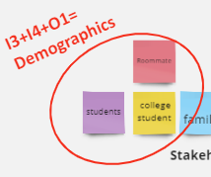
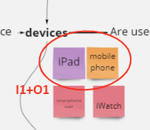
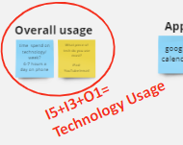
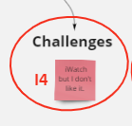
How Are User Personas Created?
3. Amalgamate each pattern in the data to form a single but coherent persona.
Demographics
Alexandra
age 18-22
college student
Devices / Behaviour variables
Uses devices, such as an IPad or mobile phone for studying and communication (multi-tasking) for many hours every day.
Attitude variables
Thinks that wearables could
be more user-friendly.

Slide 24
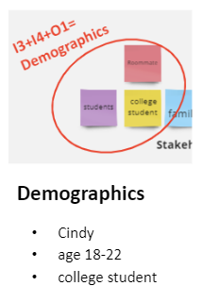
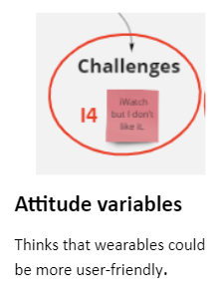
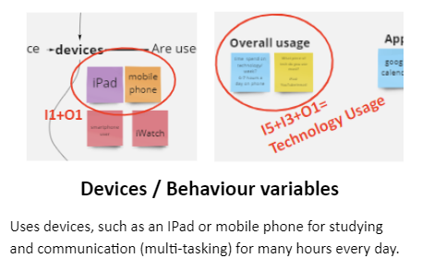
How Are User Personas Created?
Name: Alexandra Age: 20 Profession: full-time student
She thinks that mobile teach is primarily useful for communication or schoolwork. She uses her IPad to take notes in-class and the calendar on her phone to keep track of meetings, classes and homework. “I like using my IPad in-class, because it allow me to draw and take down notes at the same time. My IPad also syncs well to my IPhone.”
Alexandra thinks the wearables she is using could be easier to use by providing speech input. “I have been giving an Apple Watch for Christmas, but I found it hard to use. ”
{
Notes:
Adobe stock images

Slide 25
We need an image!
Notes:
Adobe stock images

Slide 26
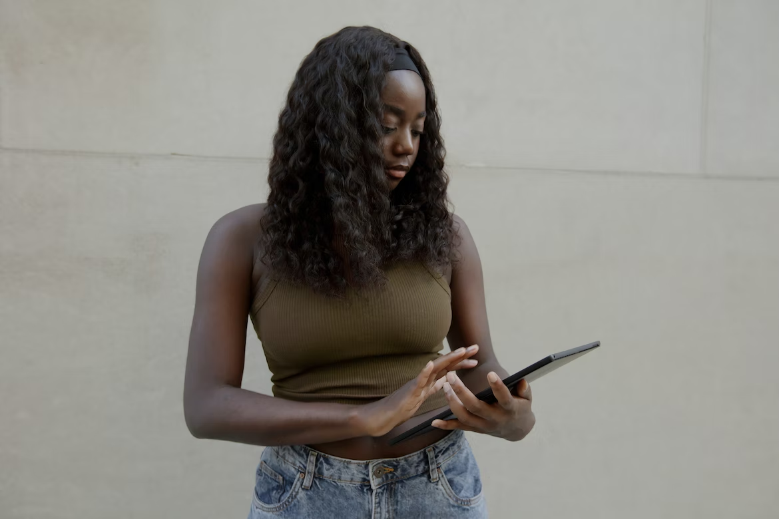
How Are User Personas Created?
Name: Alexandra Age: 20 Profession: full-time student
She thinks that mobile teach is primarily useful for communication or schoolwork. She uses her IPad to take notes in-class and the calendar on her phone to keep track of meetings, classes and homework.
“I like using my IPad in-class, because it allow me to draw and take down notes at the same time. My IPad also syncs well to my IPhone.”
Alexandra thinks the wearables she is using could be easier to use by providing speech input. “I have been giving an Apple Watch for Christmas, but I found it hard to use. ”
{
1. Find an Image
Unsplash
Adobe Stock
pixabay
Notes:
Adobe stock images

Slide 27
To Canva/Figma/Your tool of choice!
Style/Design you Persona

Slide 28
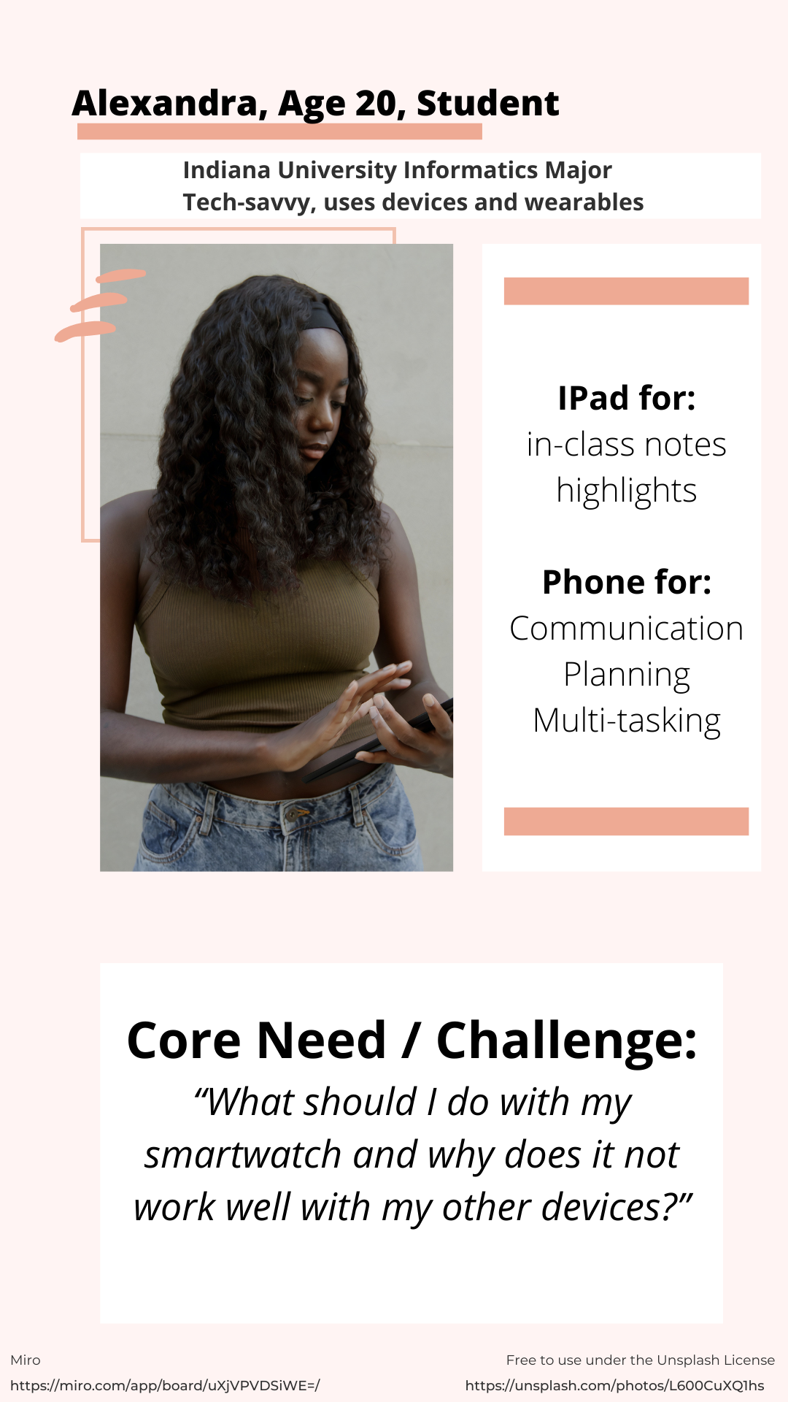
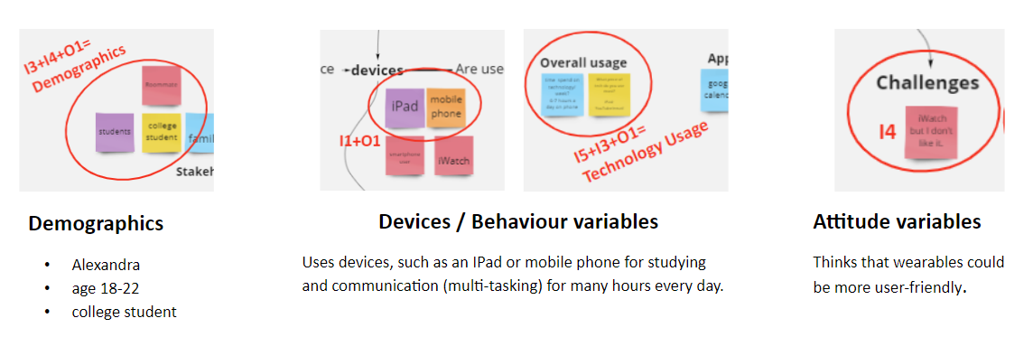
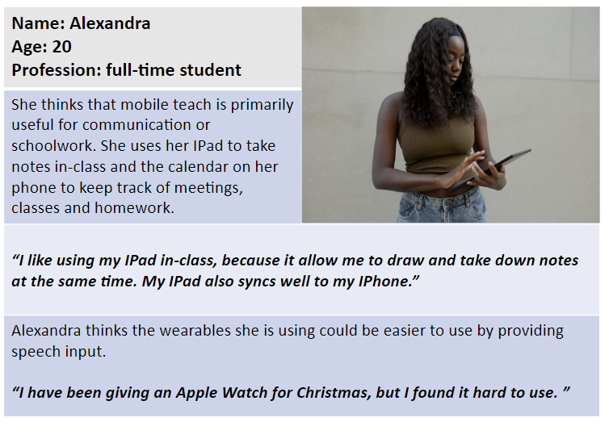
NOW
Transfer your Persona into Canva and
style it/visualize it so it communicates who you are designing for to others
Start with
patterns derived from
from actual data
(interviews)
Add fictional /speculative elements to complement and complete the Persona within the scope for your Project

Slide 29
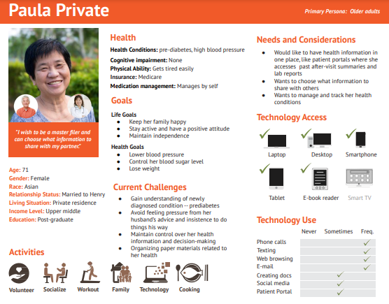
Behavioral
Attitude
Demographics

